Slide 1

Postnatal Journey Taiwan
The Postnatal Care Education System “for Mothers and Newborns
Using Emerging Media,
Virtual Reality, and Web Development”
Chiwen Lai

Slide 2

Elevator PITCH
We all talk about the medical treatment and services available in different countries during the covid pandemic. This is especially important for the parents-to-be as they just found out that they are pregnant and are looking for information to provide the best and safest care for both the mothers and the newborn. Taiwan has one of the best medical care in the world, and we also have one of the most established postnatal care systems. The 30-day postnatal care is deeply embedded in our culture, and a lot of hospitals and care centers offer different packages.
However, the 30-day postnatal care is still a new concept among the English speakers. The information available online may not be transparent or consolidated especially for the foreigners who are based in Taiwan, or those who plan to travel to Taiwan for postnatal care. These English-speaking parents-to-be don’t usually know who to go to for more information, either.
My initial goal is to create a platform that provides information for English-speaking parents-to-be in Taiwan that helps them understand the benefit of Taiwan’s 30-day postnatal care, and recommend a service provider that I personally used.
Since I am also an Early Education and Care (EEC) certified teacher in both the United States and Taiwan, therefore, I also wish to create a safe and happy community that targets both postnatal care and early education for the English-speakers in Taiwan. All the leads collected during the current project will be used in my next Concept Studio project which is targeted to launch in 2021.
This final document illustrates my process of creating the digital guide, in the form of a site, for the parents-to-be during the Pandemic. Using virtual reality and other digital media, I intend to share a quality postnatal journey with Taiwan 30-day postnatal care, and preparing postnatal and early education community with lead generation
Notes:
We all talk about the medical treatment and services available in different countries during the covid pandemic. This is especially important for the parents-to-be as they just found out that they are pregnant and are looking for information to provide the best and safest care for both the mothers and the newborn. Taiwan has one of the best medical care in the world, and we also have one of the most established postnatal care systems. The 30-day postnatal care is deeply embedded in our culture, and a lot of hospitals and care centers offer different packages.
However, the 30-day postnatal care is still a new concept among the English speakers. The information available online may not be transparent or consolidated especially for the foreigners who are based in Taiwan, or those who plan to travel to Taiwan for postnatal care. These English-speaking parents-to-be don’t usually know who to go to for more information, either.
My initial goal is to create a platform that provides information for English-speaking parents-to-be in Taiwan that helps them understand the benefit of Taiwan’s 30-day postnatal care, and recommend a service provider that I personally used.
Since I am also an Early Education and Care (EEC) certified teacher in both the United States and Taiwan, therefore, I also wish to create a safe and happy community that targets both postnatal care and early education for the English-speakers in Taiwan. All the leads collected during the current project will be used in my next Concept Studio project which is targeted to launch in 2021.
This final document illustrates my process of creating the digital guide, in the form of a site, for the parents-to-be during the Pandemic. Using virtual reality and other digital media, I intend to share a quality postnatal journey with Taiwan 30-day postnatal care, and preparing postnatal and early education community with lead generation

Slide 3


Covid, Postnatal, Parents-to-be
Medical treatment and services are very important during the Covid Pandemic
Taiwan has one of the best healthcare and the 30-day postnatal care system is popular
Information of the postnatal care system is not English-speakers-friendly
Many options in Taiwan, tough to determine which one meets the needs
Social Distancing under Pandemic prevents visiting the facilities before commitment
Postnatal isn’t an one-off short term journey, English speaking parents need to form a community for postnatal and early education to continue to provide the best care for their children long term
Elevator PITCH
Notes:
Medical treatment and services are very important during the Covid Pandemic, especially for parents-to-be. Taiwan has one of the best healthcare in the world, and our 30-day postnatal care system is becoming more and more popular. But the information of the postnatal care system and available services are not friendly to English speakers. The Taiwanese official website contains limited information on postnatal care services for parents-to-be. Therefore, my goal is to build a multimedia platform with a responsive web design that provides information to those who are interested in the postnatal care service in Taiwan.
There are many care centers in Taiwan, and parents-to-be don’t know which one is credible and suitable for their needs. Therefore, my second goal is to build content using user journey from the perspective of the parents-to-be through my own personal experience and allow these parents-to-be to reach out to me for more information.
Due to social distancing under the Pandemic, Parents-to-be are unable to visit the recommended care center to see the facilities and services. Using the emerging technologies including virtual reality video editing, my third goal is to enhance the online information browsing experience, so parents-to-be can virtually and remotely have a better understanding of what the care center offers.
My fourth goal is to use the leads collected from this platform to prepare the postnatal care and early education community for my new life project in 2021.
The website is designed to be simple and easy to operate; It contains short videos that can help parents to understand the postnatal care for both mothers and newborns and targeting those mothers who are seeking quality care with professionals, whether they’re locals or foreigners whos interesting in practice postnatal care after childbirth.

Slide 4
PROJECT GOALS
GOAL#1
Provide a Contact Window and Information Source
for Parents-to-be
Based in Taiwan
GOAL#2
Build
an Early Education Community for Newborns and Toddlers
Notes:
We all talk about the medical treatment and services available in different countries during the covid pandemic. This is especially important for the parents-to-be as they just found out that they are pregnant and are looking for information to provide the best and safest care for both the mothers and the newborn. Taiwan has one of the best medical care in the world, and we also have one of the most established postnatal care systems. The 30-day postnatal care is deeply embedded in our culture, and a lot of hospitals and care centers offer different packages.
However, the 30-day postnatal care is still a new concept among the English speakers. The information available online may not be transparent or consolidated especially for the foreigners who are based in Taiwan, or those who plan to travel to Taiwan for postnatal care. These English-speaking parents-to-be don’t usually know who to go to for more information, either.
My initial goal is to create a platform that provides information for English-speaking parents-to-be in Taiwan that helps them understand the benefit of Taiwan’s 30-day postnatal care, and recommend a service provider that I personally used.
Since I am also an Early Education and Care (EEC) certified teacher in both the United States and Taiwan, therefore, I also wish to create a safe and happy community that targets both postnatal care and early education for the English-speakers in Taiwan. All the leads collected during the current project will be used in my next Concept Studio project which is targeted to launch in 2021.
This final document illustrates my process of creating the digital guide, in the form of a site, for the parents-to-be during the Pandemic. Using virtual reality and other digital media, I intend to share a quality postnatal journey with Taiwan 30-day postnatal care, and preparing postnatal and early education community with lead generation

Slide 5

My Target Audience
Parents-to-be 1: English speakers based in Taiwan who have spent time abroad previously
obtains working visa or a resident permit in Taiwan
familiar with the area
have local friends or coworkers
have Taiwanese public health insurance coverage
Parents-to-be 2: English speakers based abroad who are planning to visit Taiwan
Do not obtain resident permit in Taiwan
Able to apply for medical visa
Language barrier is a concern
Parents-to-be 3: English and Mandarin speakers based in Taiwan
Similar to Parents-to-be 1
Price-sensitive
Convenience-oriented
Common Need 1
Need Comprehensive Information
and Source Points
Common Need 2
Need Sources that Prove Trustworthy and Credibility
Common Need 3
Need Information to Help Final Decision-making
Notes:
I have three target groups in mind.
Parents-to-be 1: English speakers based in Taiwan who have spent time abroad previously: This kind of user is the type of person who obtains a working visa or a resident permit in Taiwan. They’re usually familiar with the area and have local friends or coworkers they can gather information from. Moreover, this type of user usually has Taiwanese public health insurance coverage. Some of the medical costs will be covered by the government but not including postnatal care services.
Parents-to-be 2: English speakers based abroad who are planning to visit Taiwan: This kind of user is the type of person who does not obtain a resident visa or a resident permit in Taiwan but they can apply for a medical visa if they wish. Or the type of users who are on their vacations and happens to give birth in Taiwan. The user usually worries about the language barrier and “is the service going to be better than my own country?” those types of concerns.
Parents-to-be 3: English and Mandarin speakers based in Taiwan: This type of user is familiar with the service, but parents would compare their budget, service, transportation, and distance from home to fit their best interests for their postnatal care experience.
They all have the common needs of needing more comprehensive information and resources to gain better understanding of the Care System. They also need more credible and trustworthy sources to feel more secured and confident with the information they are receiving. And most importantly, they need the information to help them make the final decision.

Slide 6
Inspiration & Competitor Review
Insite Search Available
No user interface
Text-based
No visual content
Video
No user interface
No references / links
Partial information
Interaction available
Multimedia
Direction available
Site navigation
PDF Document
Inside a Postpartum Nursing center: Tradition and change
Video
Luxury live-in Care for mothers after giving birth
Site
Ministry of Health and Welfare Taiwan
Official website
Notes:
I have researched a few existing sources and consolidated a comparison between three distinctive media sources, including a published academic study, a video documentary, and the official website from Taiwan Ministry of Health and Welfare.
When the user clicks into Reference#1: “Inside a Postpartum Nursing center: Tradition and change,” they will see a six pages long PDF document that only allows users to download, export, and share. The PDF document provides postnatal care information for the users and it has the “in-site search” so the user can simply type in the keyword to look for the contents. But other than that, this PDF site does not include any other website’s interface or the contents, nor any images, or videos to support this research.
For Reference #2: “Luxury live-in Care for mothers after giving birth” is presented on the AP archive website, and it is a 5 mins video documentary. The website has the banner and the script for the video which can help users to easily understand the concept of the postnatal care center. But it does not allow users to actually know where to find this specific postnatal center or service.
Reference #3 is the Ministry of Health and Welfare Taiwan’s official website. I personally like the website’s layout and the contents include images, videos, text, and well-written descriptions. The website also includes the direction to each clinic and other web features including, “header, site navigation, in-site search, contact information” etc. But when I look into the gynecologist section it does not include any information about the service & care after the childbirth.
Therefore, the website I set up includes most of the functions with a clean layout. It also allows users to easily access and explore the information they need for this specific 30-day postnatal care in Taiwan.

Slide 7
Technology
WIX
Premiere Pro
Insta 360
Github
Insta 360 one R
Insta 360 studio
YouTube
TeamGantt
AfterEffets
Godaddy.com
Lightroom
&
Adobe photoshop
Google Docs
&
Google Forms
Notes:
In this capstone, I applied creative cloud applications such as Adobe Photoshop, Premiere Pro, Lightroom and After Effect to edit video tours and photos. I also adopted emerging media techniques including virtual reality to enhance the content experience during Pandemic. For the 360 video shoot, I’ve chosen Insta 360 one R to record the Virtual reality videos. With the application of frontend, backend framework, web programming integrating with user personas and user journey mapping techniques, I wish to achieve an optimal user experience.

Slide 8
User Journey STeps
Entering the Site
Assured, welcomed
Step 1
Know the benefits
of the System
Step 2
Know what the System offers
Step 3
Know detail specs of the System
(Services)
Step 4
Know detail specs of the System
(Meals)
Step 5
learn what solutions are offered
Call To Action
Contact for More
Leave a Feedback
Notes:
I illustrated a common user journey across the three user personas I targeted in this project to design and build the site.
The user journey of my website covers 6 key steps for the parents-to-be to gather information they need for a better understanding on the Taiwan 30-day Postnatal Care system.
They need to feel welcomed and assured when they first enter the site; then they need to know the benefits of the system. After that, they need to know what the system offers them.
For those users who need more information to compare, they need to discover more information in details regarding the areas they need, particularly in services and meals. Some of the parents also need to know more unique selling points in the solutions of baby caring, mother recovery before making the final decision.
Throughout each step, they can jump to step 6, which is the call to action of this site for now, to contact me for more information directly, as well as leaving the contact information for future purpose.

Slide 9
USER FEEDBACK via Online Survey
Survey Result & Conclusion
Total of 9 respondents
All 9 respondents are satisfied with how the site met their needs, and found the site easy or okay to navigate
The respondents found the VR tour videos the most appealing content
90% of the people found the VR tour helpful in understanding the theme of the page
7 out of 9 people found the site visually appealing
To Improve:
Simplify navigation by simplifying Footer, adding a site map
Simplify copies on the site
Improve usability of the VR user experience
SURVEY AREAS
Ease of use (based on impression, time spent)
User Satisfaction
Content Appealingness and Usefulness
Design Appealingness
Areas of Possible Improvement (recommendation & pain point)
Mechanism:
9 Selected Participants invited via LINE with Google Forms
Survey Link: https://forms.gle/CGY43uJBxxjjbM3b7

Slide 10
The final product of this capstone project is my phase 1 delivery of my own personal portfolio. I am an Early Education and Care (EEC) certified teacher in both the States and Taiwan, and my aspiration has always been creating my own line of the early education system that helps parents who are willing to explore an education system that is different from the conventional one.
By providing my own experience on the Taiwan 30-day postnatal care system, it does not only helps those seeking for information during Pandemic but also increases exposure to my professional background. I am able to test contents and collect leads among the target audience groups I aim for, and all the leads collected during the current project are going to be my beta group for my Concept Studio project, a family classroom designed for toddlers age from 1 to 3 years old. I wish to launch the Studio in 2021.
Beyond Capstone & Continue
Notes:
Digital media along with other emerging media types have been an inseparable tool in our society. By improving the skills and capability in mastering this media, I can convey my ideas and content more effectively to the people I am interested in communicating with. I realise there are much more I need to perfect and improve, and it is my goal to continue with this practice even beyond the Capstone.
The final product of this capstone project is my phase 1 delivery of my own personal portfolio. I am an Early Education and Care (EEC) certified teacher in both the States and Taiwan, and my aspiration has always been creating my own line of the early education system that helps parents who are willing to explore an education system that is different from the conventional one.
By providing my own experience on the Taiwan 30-day postnatal care system, it does not only helps those seeking for information during Pandemic but also increases exposure to my professional background. I am able to test contents and collect leads among the target audience groups I aim for, and all the leads collected during the current project are going to be my beta group for my Concept Studio project, a family classroom designed for toddlers age from 1 to 3 years old. I wish to launch the Studio in 2021.

Slide 11
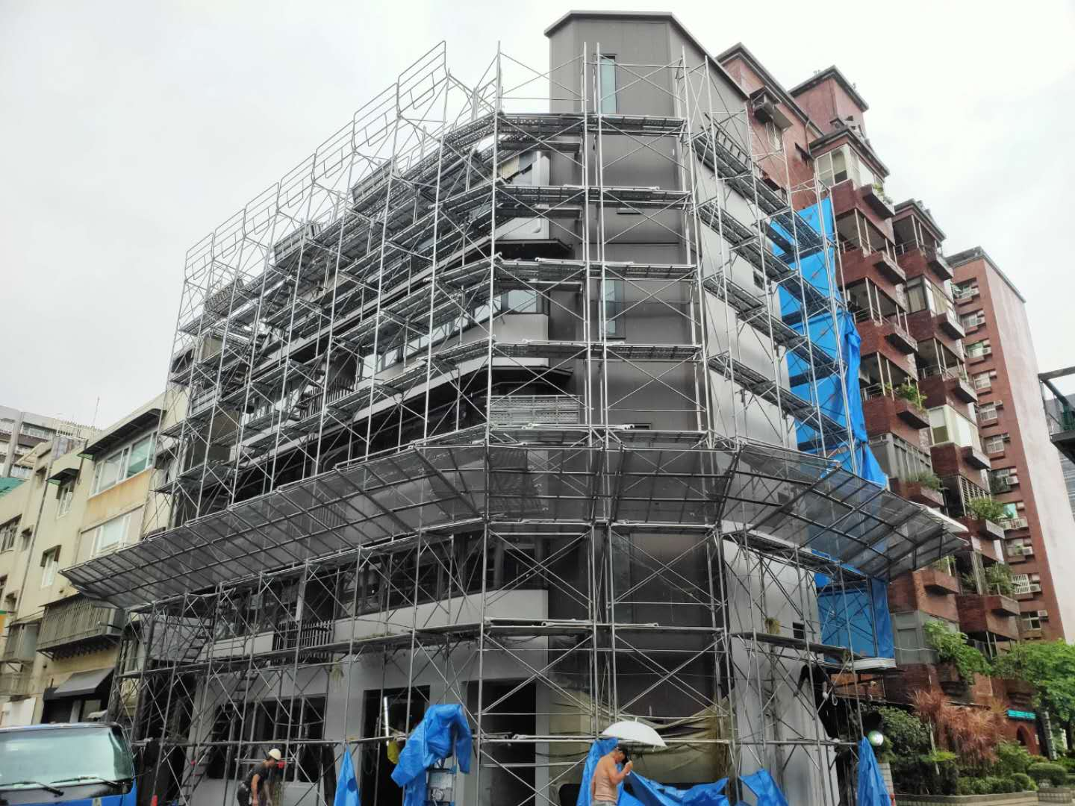
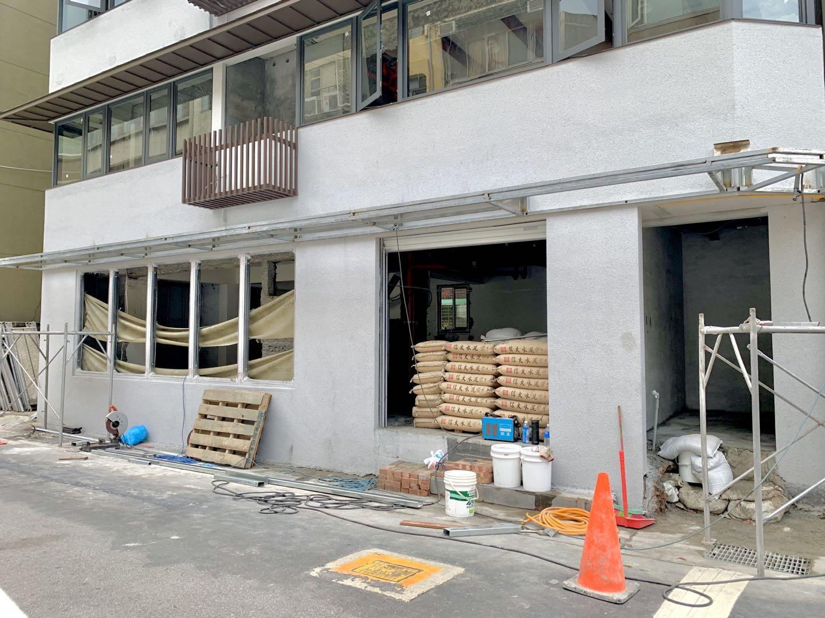
Concept Studio
COming Up Soon
Notes:
Digital media along with other emerging media types have been an inseparable tool in our society. By improving the skills and capability in mastering this media, I can convey my ideas and content more effectively to the people I am interested in communicating with. I realise there are much more I need to perfect and improve, and it is my goal to continue with this practice even beyond the Capstone.
The final product of this capstone project is my phase 1 delivery of my own personal portfolio. I am an Early Education and Care (EEC) certified teacher in both the States and Taiwan, and my aspiration has always been creating my own line of the early education system that helps parents who are willing to explore an education system that is different from the conventional one.
By providing my own experience on the Taiwan 30-day postnatal care system, it does not only helps those seeking for information during Pandemic but also increases exposure to my professional background. I am able to test contents and collect leads among the target audience groups I aim for, and all the leads collected during the current project are going to be my beta group for my Concept Studio project, a family classroom designed for toddlers age from 1 to 3 years old. I wish to launch the Studio in 2021.

Slide 12
Website Demo
Postnatal Journey website
Notes:
After the potential parents-to-be discover my website either via social media or search engine, they will land on the one-page website.
Entering the Site - The user will be welcomed by a short opening animation with the logo.
Step 1 - After scrolling down to the first section, the first content they see is the brief comparison between traditional postnatal care and new postnatal care provided by the care center. This can refresh their knowledge in postnatal care, and also highlight why it is important to use the postnatal service provided by the care center.
Step 2 - The parents-to-be will see the environments and facilities the Care Center I chose and used provides. The reason for demonstrating the facilities and environment is because it is difficult to compete with such facilities. It is very difficult to have the same facilities anywhere other than this care centre. Each facility provides a critical function to the 30-day postnatal journey. During Pandemic, it is impossible to have a physical tour in the Center unless you are the parents and babies using the service. In order to showcase the experience better, I create these VR videos to recreate the surrounding for maximum experience.
Step 3 - The parents-to-be will see a range of available services the postnatal care covers.
Step 4 - The parents-to-be will see meals provided by the care center that customise nutrition for mothers’ recovery and babies’ best growth.
Step 5 - The parents-to-be will see a list of activities provided by the care center that foster parenting skills, parent-child bonding, and health recovery. This is important to the parents-to-be and the project because their journey doesn't end after 30 days. The 30 days is to prepare them for a smoother and easier transition from the 31st day onwards.
Call To Action (Step 6) - Throughout the section, the parents-to-be will be able to contact me for more information. I will contact these parents for more related information as my own parental journey proceeds, and we can share different resources and establish a care system together as our needs progress together. I would like to expand this website into the area of the concept studio for early education care in near future.
Other Available Features
The main content on the Site is about providing information on Taiwan 30-day Postnatal Care system:
Brief comparison between the traditional system and the new 30-day postnatal care system
Available services parents can expect during the 30-day system
Facilities filmed and presented in the VR tours (Common Area, Breastfeeding Room, Bedroom)
Meal arrangement during the 30-day system
Available activities parents take during the 30-day system
Swimming Session VR video
Prenatal Yoga courses
Bathing instruction
Lactation instruction
Aside from the key content, the users are able to use the contact me page to contact me directly with a form to leave feedback. I’ve also provided a resource page linked directly to the Taiwan Travel Official site Visa Page so overseas foreigners will be able to discover traveling related information.
Last but not the least, since this Capstone Project is part of my future project, I am in the process of creating a Concept Studio VR video which is going to be the next step of my coming up soon future plan

Slide 13
Notes:
If you are interested, I have provided the links and references being used in my project in the appendix. I hope you enjoy this site and the concept it represents. Please feel free to visit the site via the link provided in the appendix and leave me comments for any improvement. I will continue to work on this site and expand it as part of my life project in the near future.

Slide 14
References and LInks
Website
Postnatal Journey website
VR Tour Videos
Breastfeeding Room Tour
Common Area Tour
Baby’s Room Tour
Swim Session
Bedroom Tour
Animation
Welcoming screen
Intro for the VR videos

